Slide 1
CAP256
Transmission Media
Part I
Reference Book
Data Communications and Networking By Behrouz A. Forouzan
Dr. Avinash Bhagat
Asst. Professor.
School of Computing Applications
Lovely Professional University
avinash.bhagat@lpu.co.in
avinash.bhagat@gmail.com
94632-81930

Slide 2
Transmission Media
A transmission medium can be broadly defined as anything that can carry information from a source to a destination.
The transmission medium is usually free space, metallic cable, or fiber-optic cable.
The information is transmitted in the form of electrical, electromechanical or optical signals.

Slide 3
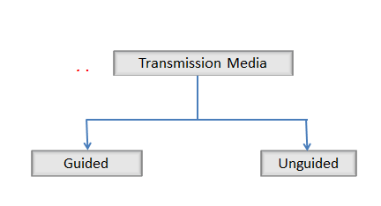
Transmission Media

Slide 4
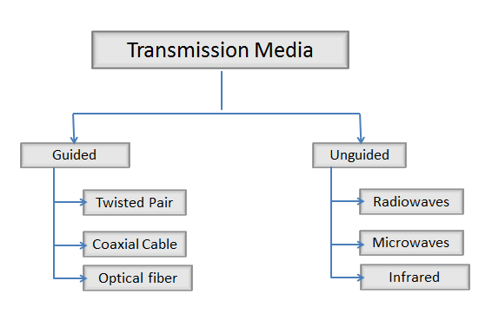
Transmission Media

Slide 5
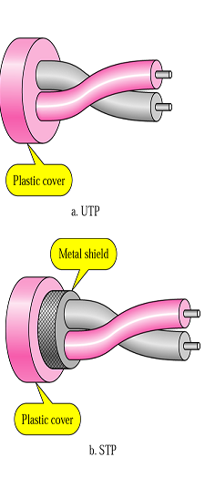
Twisted Pair Cable
Consists of two copper wires about 1 mm thick.
One wire carries the signal and other is used for ground reference.

Slide 6
Twisted Pair Cable
Twisting reduce the electrical interference from the similar pairs in the surroundings.
Performance of wire increased with number of twists

Slide 7
Twisted Pair Cable
STP cable has a metal foil or braided mesh covering that encases each pair of insulated conductors.
This metal casing improves the quality of cable by preventing the penetration of noise or crosstalk.

Slide 8
Twisted Pair Cable
it is bulkier and more expensive.
STP is seldom used outside of IBM.

Slide 9
Twisted Pair Cable
Categories
The Electronic Industries Association (EIA) has developed standards to classify unshielded twisted-pair cable into seven categories.
Categories are determined by cable quality, with 1 as the lowest and 7 as the highest.

Slide 10
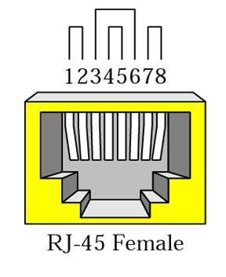
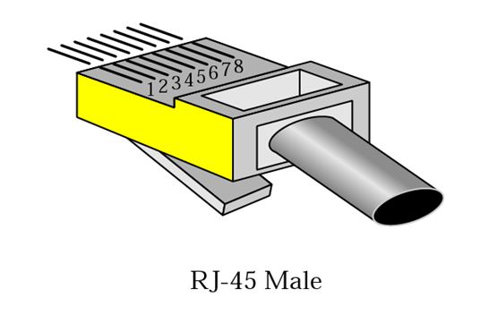
Twisted Pair Cable
Connectors
The most common UTP connector is RJ45 (RJ stands for registered jack),
The RJ45 is a keyed connector, meaning the connector can be inserted in only one way.

Slide 11
Twisted Pair Cable
Applications of Twisted pair cables
UTP are cheapest media and is used in many applications
  Local loop in telephone lines
  Digital subscriber line (DSL)
  LAN

Slide 12
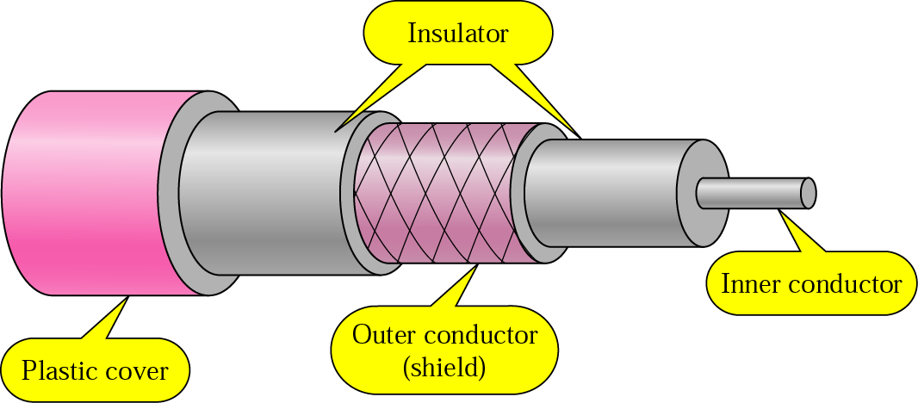
Guided Media Coaxial cable
Consists of a hollow outer cylindrical conductor that surrounds a single inner wire conductor that surrounds a single inner wire conductor.

Slide 13
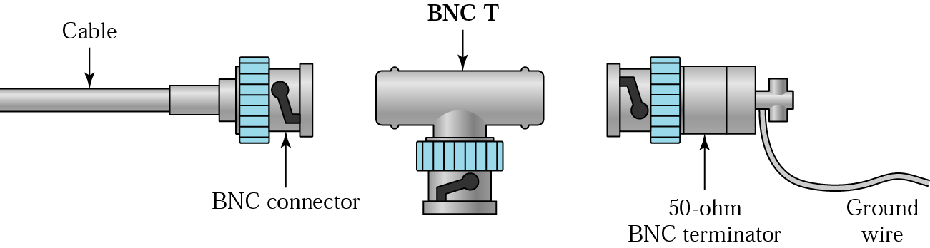
Guided media Coaxial cable
Due to its shielding coaxial cables are much less susceptible to interference or crosstalk than twisted pair.
Bayonet Neill Concelman connector is used.

Slide 14
Applications of Coaxial Cable
Television distribution as BW is high
Long distance telephone transmission (10,000 voice channels per cable simultaneously because of higher BW)
LAN

Slide 15
Guided Media Optical Fiber
An optical fiber is a thin (2 to 125 micrometer), flexible medium capable of conducting an optical ray.
It is made of ultra pure fused silica, glass fiber or even plastic
It has a cylindrical shape and consists of three concentric sections
  Core
  Cladding
  jacket

Slide 16

Guided Media Optical Fiber
The core consists of one very thin strands of fibers made of glass or plastic.
The cladding is a glass or plastic coating that has optical properties different from the core
The jacket surrounds one or a buddle of cladded fibers.

Slide 17
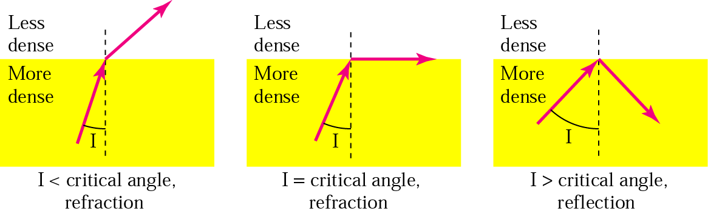
Guided Media Optical Fiber
How Optical fiber works

Slide 18
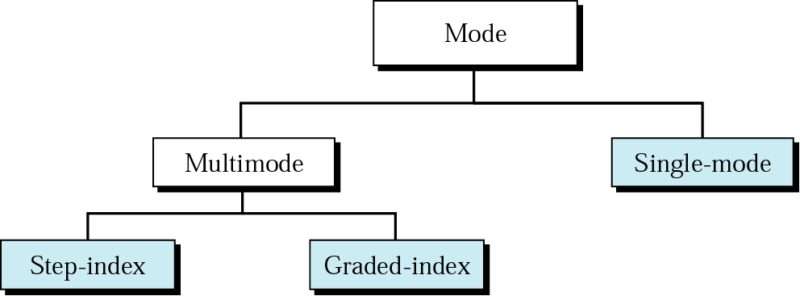
Figure 7.12 Propagation modes

Slide 19

Classification of Optical Fiber
Multiple Mode Step Index: Refers to the variety of angles that will reflect. Multiple propagation path exists, signal elements spread out in time and hence the data rate

Slide 20
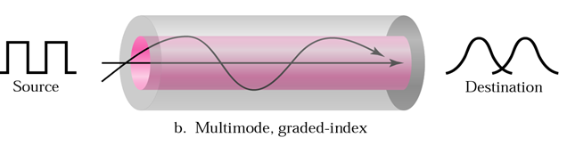
Classification of Optical Fiber
Multiple Mode Graded Index: By varying the refractive index of the core, rays may be focused more efficiently than multimode.

Slide 21
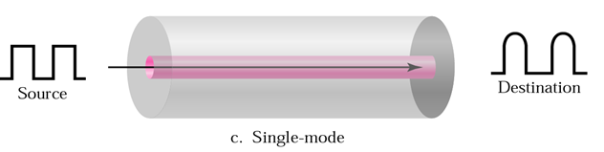
Classification of Optical Fiber
Single Mode: When fiber core radius is reduced, fewer angles will reflect By reducing the radius of the core to the order of a wavelength, only a single angle or mode can pass – the axial ray.

Slide 22
Mode of communication in optical fibers
Single Mode
Multimode
Much less distortion as only
Repeater spacing will be much long
Diameter of the cable is less approximately 7mico meter
More prone to distortion
Repeater are required at less distance
Diameter of the core is more 50, 62.5 and 100 micro meter

Slide 23
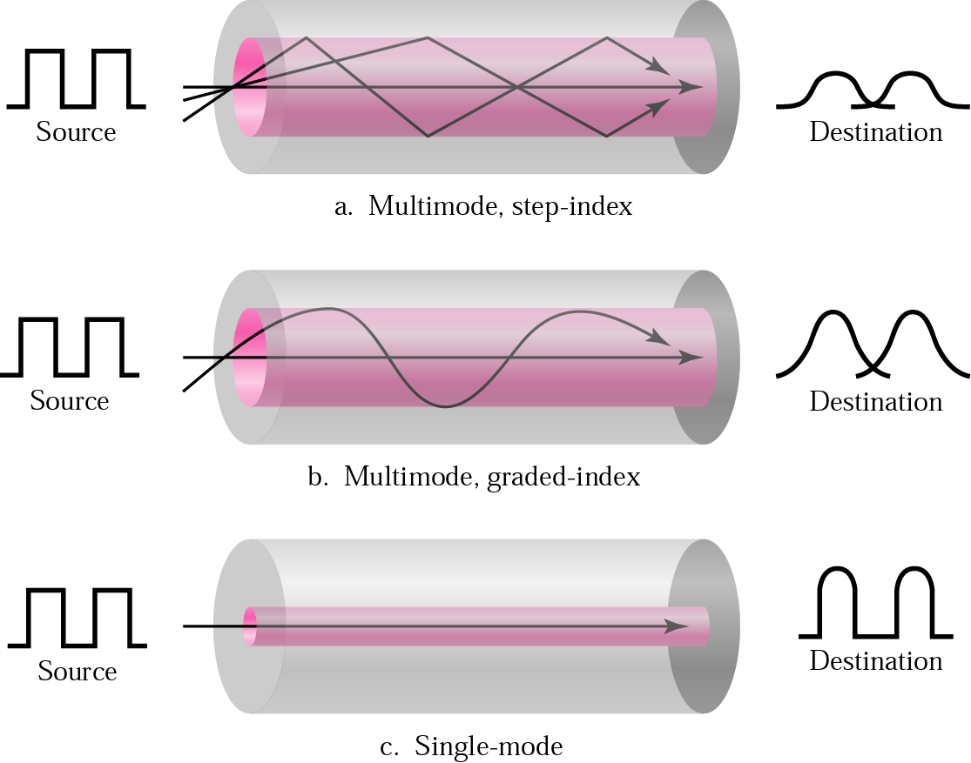
Figure 7.13 Modes

Slide 24
Review Questions
Q1 On what parameters the quality of transmission depends in case of guided transmission media?
Q-2. Why wires are twisted in case of twisted pair of transmission medium?
Q-3. Give a popular example where co-axial cables are used for broadband signaling.

Slide 25
Review Questions
Q-4. What devices are used as source and detector in case of single mode of fiber?
Q-5. In what way multi-mode and single-mode fibers differ?
Q-6. Why does single-mode fibres are used for large distance communications rather than multi-mode fibres?

Slide 26
Review Questions
Q-7. What is crosstalk? How is it minimized in case of twisted-pair of wire?

Slide 27
References :
Text Book:
  Behrouz A. Forouzan, Data Communication and networking, 4th Ed., Tata McGraw Hills year of publication 2006
Other Specific Book:
  Andrew S. Tanenbaum,Computer Network 2nd Edition, PHI, Third Edition 1997
  Comer E. Doughlas,Computer Networks and Internets, 2nd Ed., Pearson, 2000
  W. Stallings,Data and Computer Communications, 7th Ed., Pearson, 2002.

